Slide 1
The Greater Wall PowerShell Framework

Slide 2
Remoting Requirements
Requirements
Full Language mode enabled
$ExecutionContext.SessionState.LanguageMode
$ExecutionContext.SessionState.LanguageMode = 'fulllanguage’
Unrestricted execution policy
Set-exeuctionpolicy –scope currentuser unrestricted -force
WinRM Enabled
Enable-psremoting –force
Set-item wsman:\localhost\client\trustedhosts –value *
Firewall profile set to private or domain
Set-netConnectionprofile –networkcategory private
Administrative credentials

Slide 3
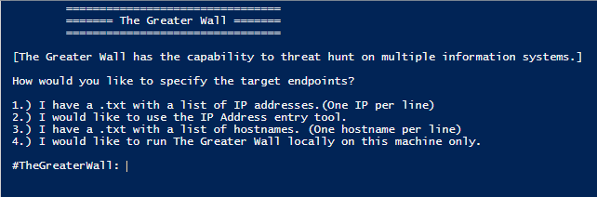
The Greater Wall PowerShell Framework
What is it?
Hunt and data collection framework
Agentless
Written entirely in PowerShell
Customizable

Slide 4
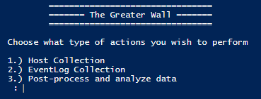
The Greater Wall PowerShell Framework
Capabilities

Slide 5
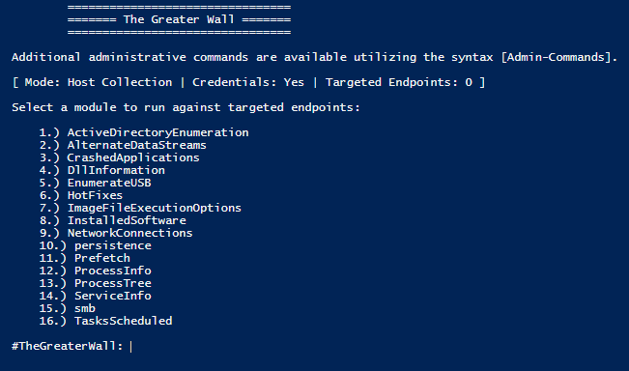
The Greater Wall PowerShell Framework
Host Collection

Slide 6
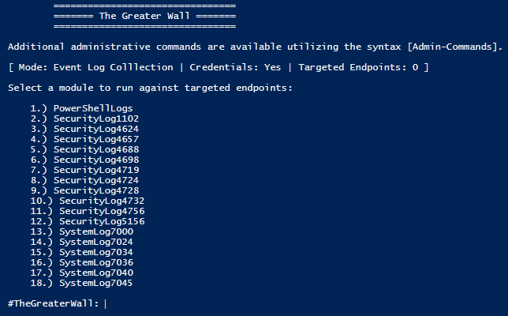
The Greater Wall PowerShell Framework
Event Log Collection

Slide 7
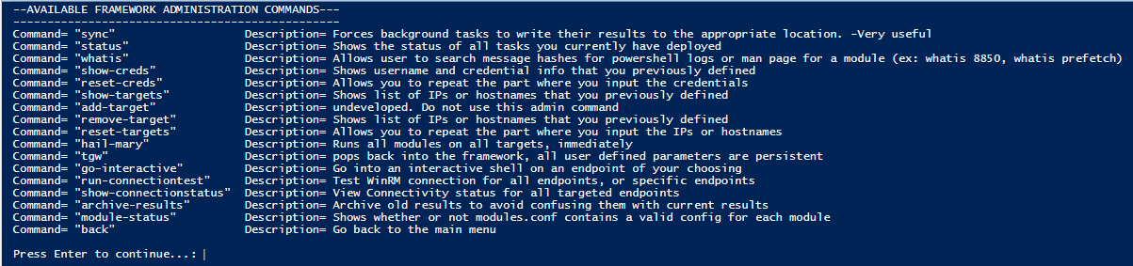
The Greater Wall PowerShell Framework
Additional features

Slide 8
The Greater Wall PowerShell Framework
Downloading and installing
Zip File
Setup.ps1
Very quick and simple

Slide 9
The Greater Wall PowerShell Framework
Exercise
Download and Install the Framework

Slide 10
The Greater Wall PowerShell Framework
Navigation
Menu driven
Basic movement commands
“back” to go back
“Ctrl+C” to exit framework
“Tgw” re-enter the framework

Slide 11
The Greater Wall PowerShell Framework
Exercise: Basic Navigation
Ensure that your system has all the requirements taken care of (Winrm, Language mode, trustedhosts and firewallpolicy)
Download TheGreaterWall.zip
Unzip the folder and run the install script
Once TGW is running, do the following
Enter your loopback ip as the target ip (127.0.0.1)
Run the connection test
Enter creds
Navigate to Host Collection
Type “admin-commands”
Hit Enter
Go back
Navigate to EventLog collection
Go back
Ctrl+c
tgw

Slide 12
The Greater Wall PowerShell Framework
Running Modules
Ran in the background
Limitations are based on analyst hardware
Must be manually sync’d

Slide 13
The Greater Wall PowerShell Framework
Demo: Running a module, viewing the status, and syncing
Choose module and run it
Type “status”
If complete; type “sync”
Ctrl+C to exit TGW and view results
Potential issue
There is no good way to verify the correctness of the credentials you supplied. If, upon running “status”, you see that it is “blocked”, the most common reason is that your credentials did not work.

Slide 14
The Greater Wall PowerShell Framework
Exercise: Running a module
CTRL+C out of TGW and cd into the results folder to verify that there is nothing in there
Type “TGW” to get back into the framework
Everything should be already set up and ready to go from the actions you did previously
Choose Host Collection
Type “admin-commands”
Look for the command to reset your IP list
Run that command
Change the IP list according to the table on this slide
Choose option 6 – Hotfixes (simply because this one will finish very quickly)
Type “status”
If it is still running, just hit enter, wait a couple seconds and try again
Once it is complete, type “Sync”
CTRL+C out of TGW and revisit your results folder

Slide 15
The Greater Wall PowerShell Framework
Post Processor
1 core feature
Surprisingly fast
Outlyer analysis
Does x show up on less than half of the computers?

Slide 16
The Greater Wall PowerShell Framework
Exercise
Run the post processor against your data sets
View the results located in $env:userprofile/Desktop/TheGreaterWall/Results/postprocessing*/AnalysisResults/OutlyerAnalysis/
You can view these results with either of the following
Notepad
Excel
Get-content nameoffile.csv | convertfrom-csv (preferred method)

Slide 17
The Greater Wall PowerShell Framework
Discussion
Raw Data

Slide 18
The Greater Wall PowerShell Framework
Other features
Interactive access
“Whatis” basically a man-page for each module (Ex: whatis processinfo)
PowerShell Log reconstruction. If The flagged powershell log is fragmented (Ex: Scriptblock 12 of 40) the entire log will be reconstructed and named with the .collection file extension.
Coming soon
Winlogbeat/Security Onion support
Job queue support
More modules

